Slide 1
Workforce Development Spotlight: November 2022 A Summary of Upcoming Career Compass and WFD Opportunities
New Content Coming Your Way!
Live Webinars Coming This Month
Making Strategic Thinking Part of Your Daily Routine (Strategic Thinking; Advanced/Expert) – 15 & 17 Nov
https://www.navfac.navy.mil/Careers/Career-Compass-Workforce-Development/Career-Compass-Resource-Center/Competency-Development-Content/Strategic-Thinking/
SYSCOM Training Opportunities
Please see the following page for additional opportunities. The Career Compass Event Calendar includes upcoming learning opportunities and trainings across the SYSCOM. More details: https://www.navfac.navy.mil/Careers/Career-Compass-Workforce-Development/Career-Compass-Resource-Center/Event-Calendar/
On-Demand Webinars and Resources Coming This Month
Strategic Thinking (early Feb)
Podcast: Up Your Strategic Thinking in 5 Minutes a Day (Advanced/Expert)
Job Aide: 4 Tips to Incorporate Strategic Thinking (Advanced/Expert)
https://www.navfac.navy.mil/Careers/Career-Compass-Workforce-Development/Career-Compass-Resource-Center/Competency-Development-Content/Strategic-Thinking/
For additional details, please talk to your local Civilian Training Advocate (BD17).
*Note: If you are unable to copy and paste the links above, QR codes are available on the following page.

Slide 2
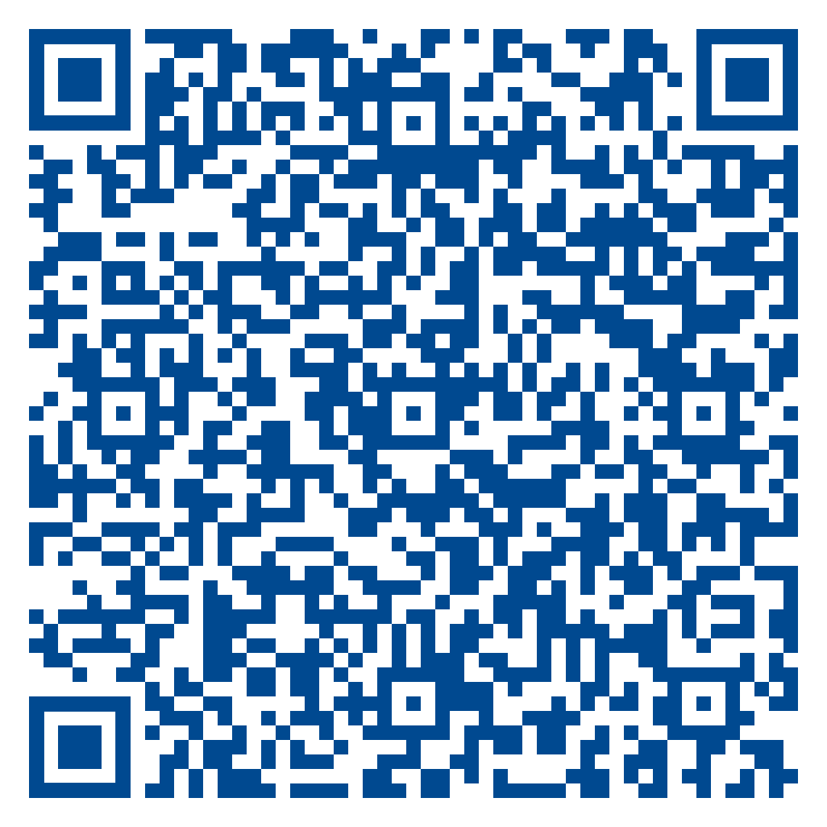
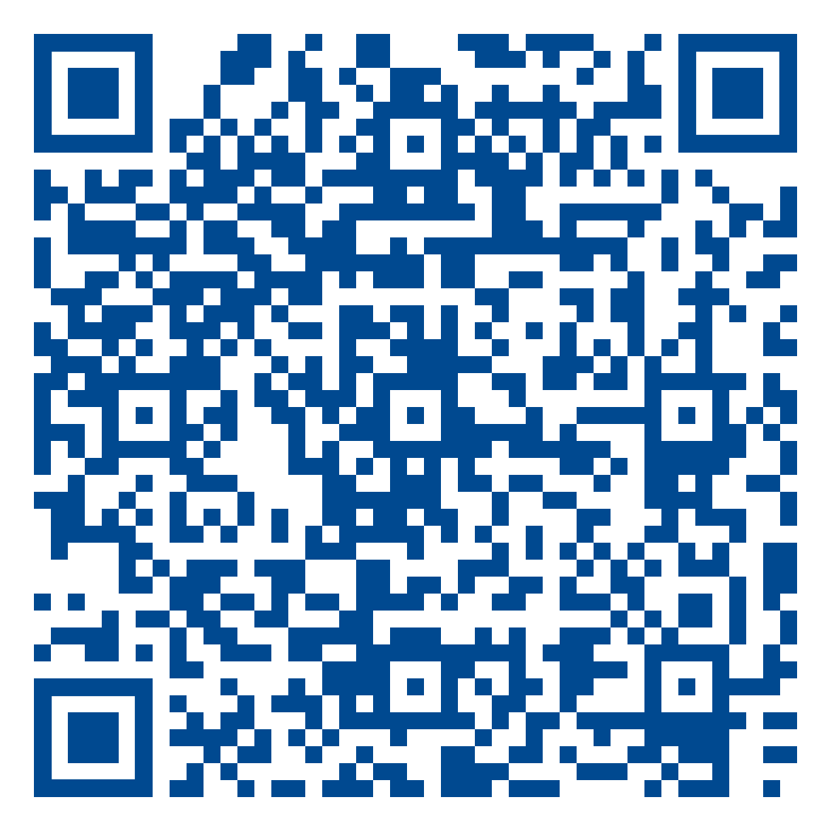
November SYSCOM Training Summary
The QR codes below can be used to access the pages referenced in the previous slide.
Start Date | Event
Tue, 01 Nov | Mid-Career Retirement Training (West)
Tue, 01 Nov | Pre-Retirement Training (West)
Wed, 02 Nov | Project & Program Management (East)
Mon, 07 Nov | Early Retirement Training (East)
Mon, 07 Nov | Current Supervisor Training II
Tue, 08 Nov | Project & Program Management (West)
Mon, 14 Nov | Current Supervisor Training I
Tue, 15 Nov | Financial Management Training (West)
Tue, 15 Nov | Pre-Retirement Training (East)
Tue, 29 Nov | Mid-Career Retirement Training (East)
Wed, 30 Nov | Financial Management Training (East)
Strategic Thinking Competency Page
December Courses Open for Registration
Career Compass Event Calendar
Start Date | Event | Registration Deadline
Tue, 06 Dec | Pre-Retirement Training (East) | TBD
Additional SYSCOM trainings are planned for Dec and will be added as dates are available. | Additional SYSCOM trainings are planned for Oct and Nov and will be added as dates are available.

